Slide 1
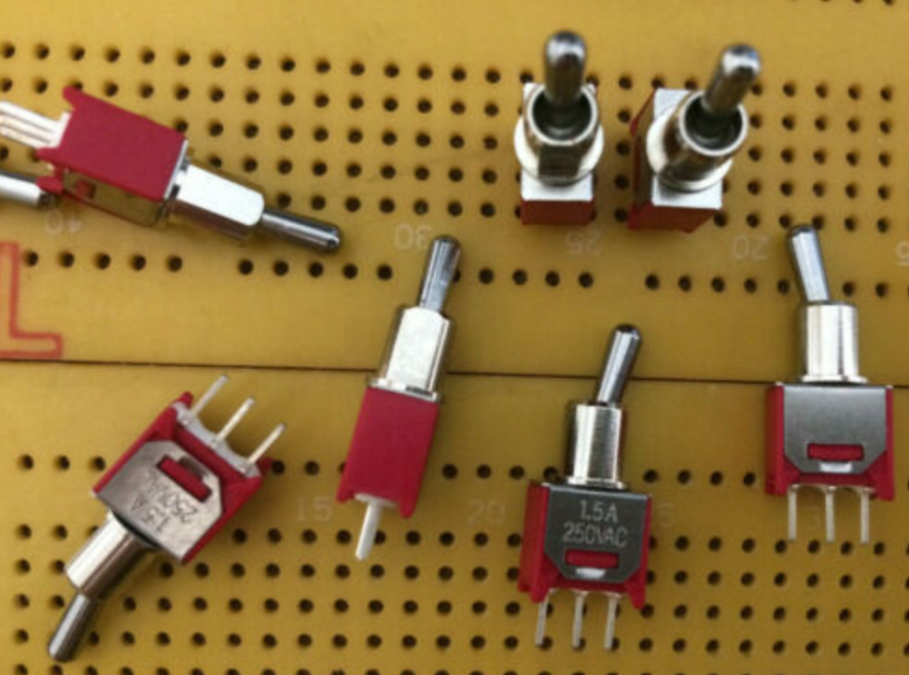
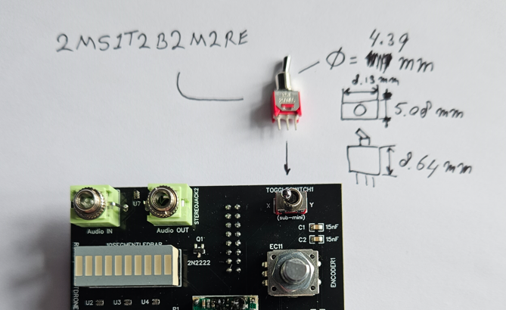
Toggle Switch (ON-NONE-ON) (1x)
https://cpc.farnell.com/multicomp/mc2ms2t2b2m2re/switch-pcb-spdt-vert/dp/SW02457
Man. Part Number: 2MS1T2B2M2RE

Slide 2
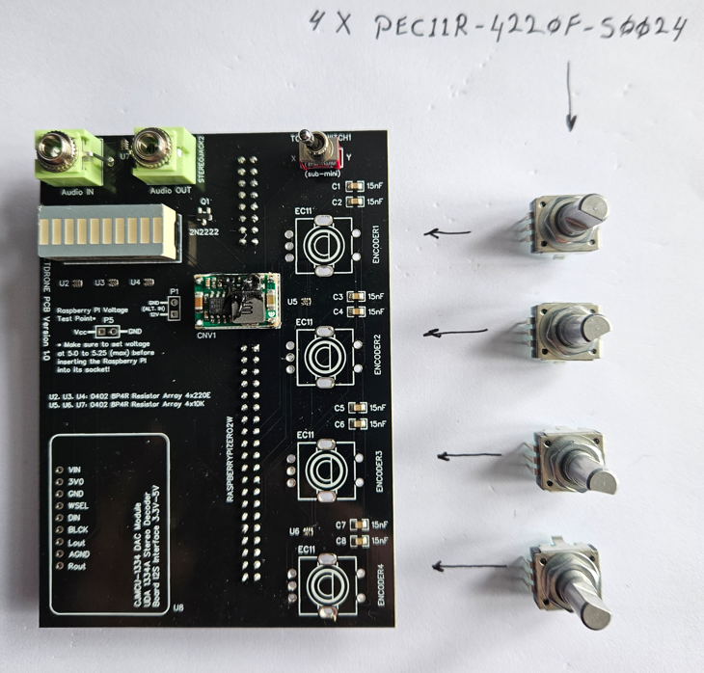
Encoders (4x)
https://uk.rs-online.com/web/p/mechanical-rotary-encoders/7377767
Man. Part Number: PEC11R-4220F-S0024

Slide 3
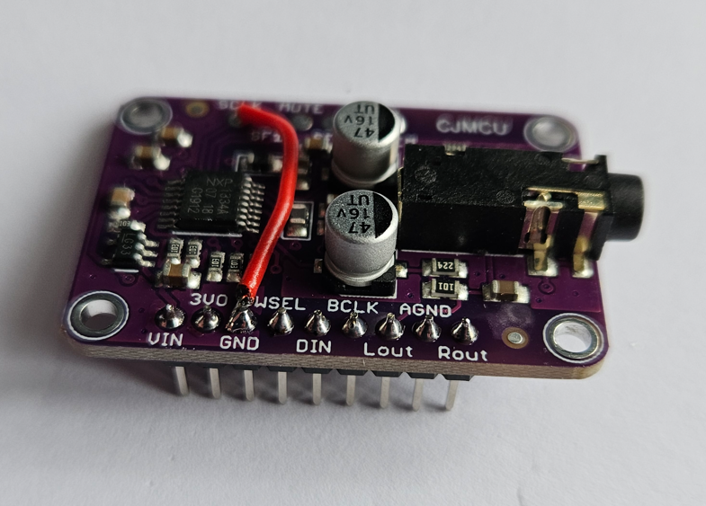
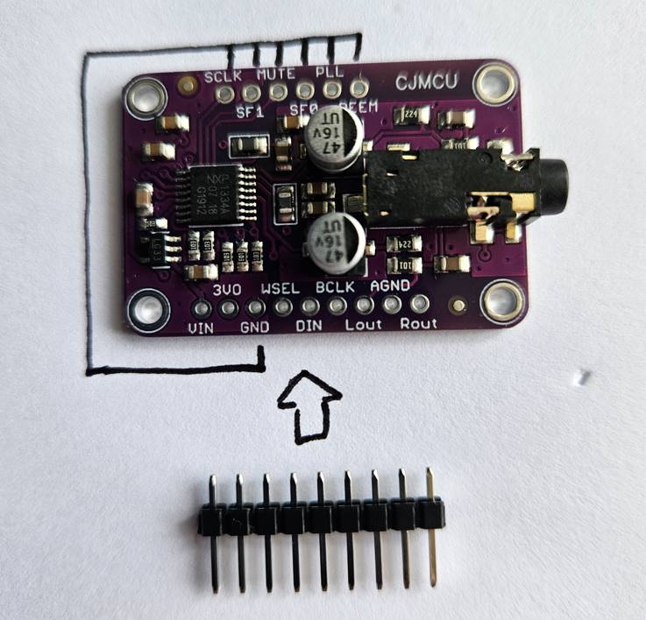
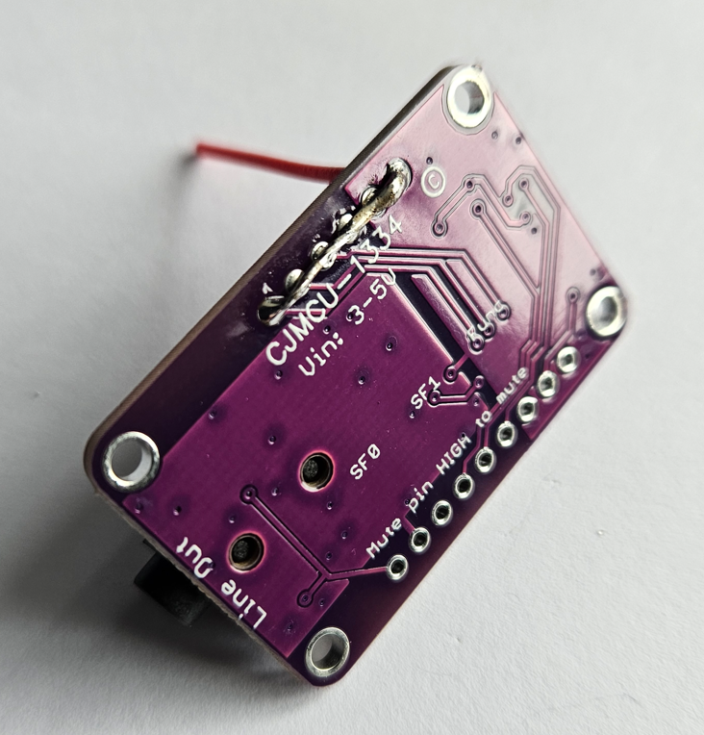
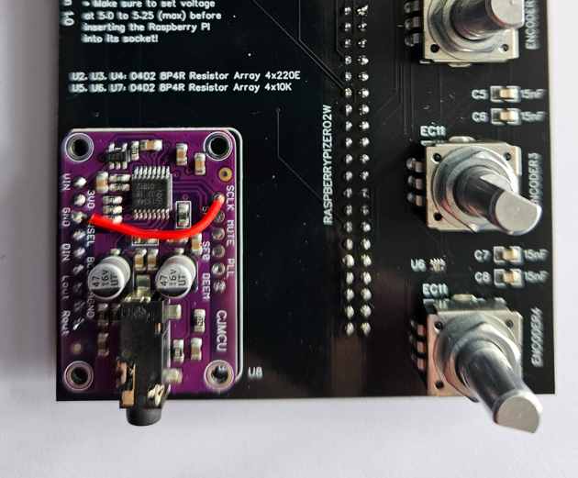
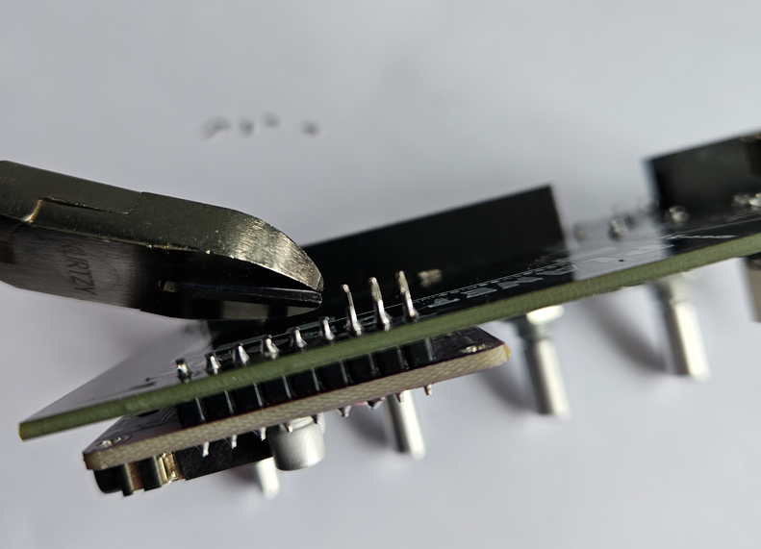
Audio Board (1x)
https://www.aliexpress.com/item/1005004794867267.html
Man. Part Number: CJMCU-1334 DAC Module
MODIFICATION: The top 6 connections must be properly grounded (connected to GND)

Slide 4

Stereo 3.5mm Sockets (2x)
https://www.thonk.co.uk/shop/3-5mm-jacks/
Green Thonkiconn Stereo 3.5mm Audio Jacks
Man. Part Number: PJ366ST
The 3.5mm (Stereo) sockets from Thonk are extremely reliable

Slide 5
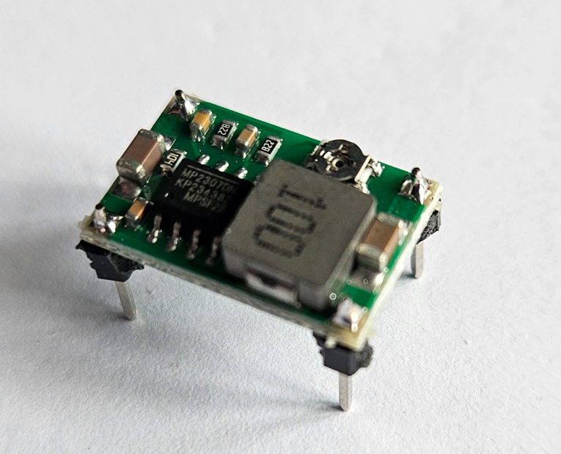
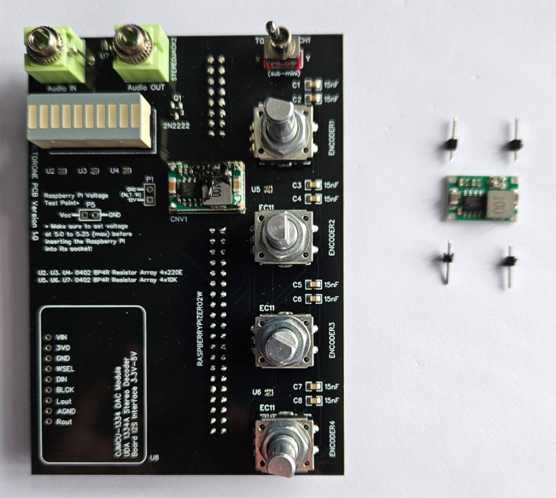
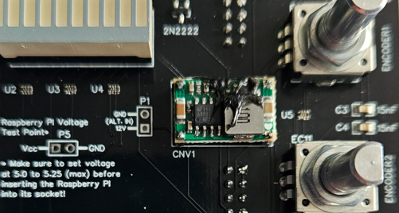
Step-down board (1x)
https://www.aliexpress.com/item/4000552565629.html
Man. Part Number: Mini 360
IMPORTANT: after setting the output voltage to about 5 Volt, make sure to glue the pot!

Slide 6
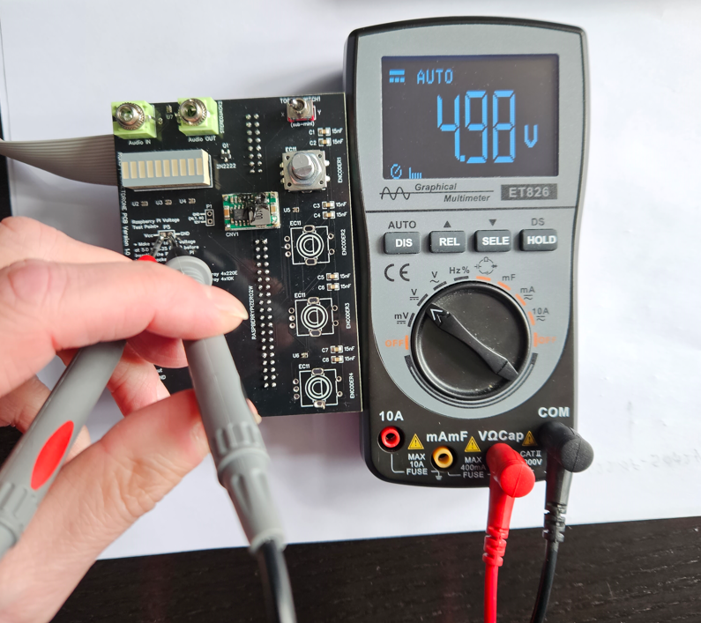
Step-down board (measure output voltage)
IMPORTANT: make sure that you measure 5V (5.25Vmax!) – and that the Step-down board’s potentiometer is glued to prevent the output voltage to change over time.

Slide 7
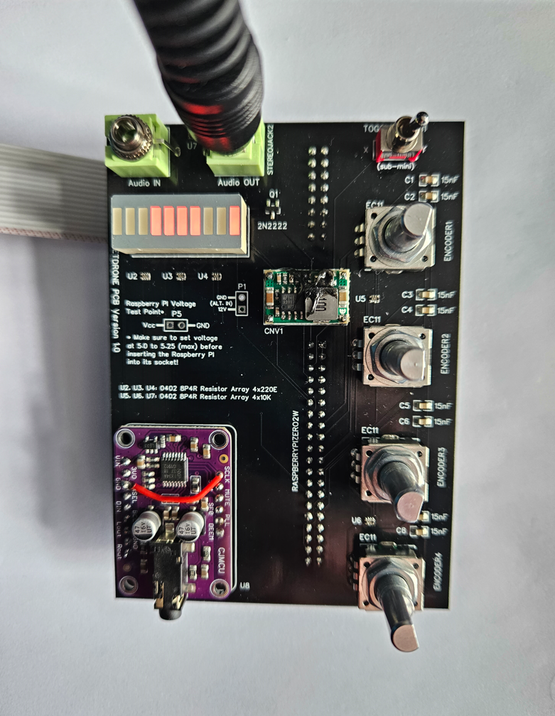
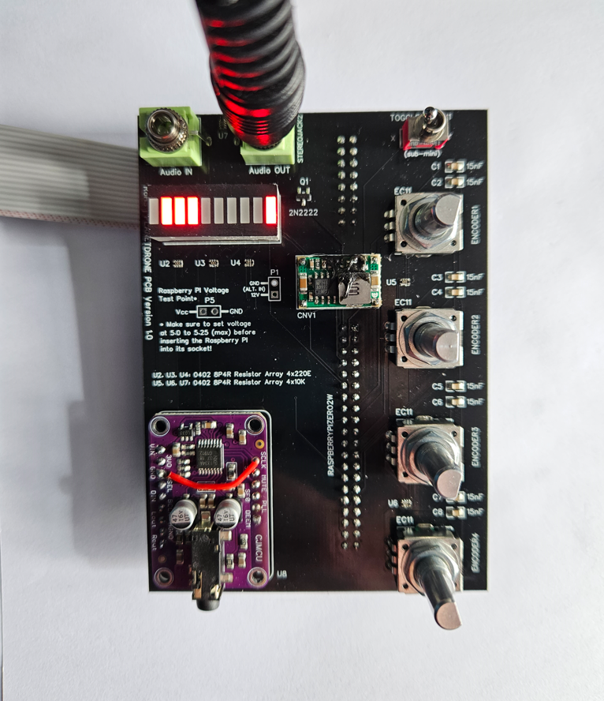
10LEDs Bar Graph
… either Amber or Red LEDs work best. Green, Blue etc. will show up very bright.

